Slide 1

ATM Interface in Java
CONSOLE BASED APPLICATION

Slide 2
CONTENT
Abstract
Introduction
Objective and Benefits
Architecture
Flowchart
Output Screens
Conclusion

Slide 3
Abstract
The Java Console-based ATM Interface is a robust and user-friendly software application designed to provide customers with seamless access to their bank accounts through a text-based console interface. Developed using Java, this application offers essential banking operations, including displaying transactions, making deposits, withdrawals, checking account balances, transferring funds, and exiting the interface.
The primary goal of this project is to create an efficient and secure platform that allows customers to manage their financial activities without the need for a graphical user interface. The purpose of this project is to provide a user-friendly, efficient, and secure way for bank customers to interact with their accounts and perform various banking operations through a text-based console interface.

Slide 4
Introduction
The ATM Interface in Java is a console-based application that replicates the functionalities of a traditional Automated Teller Machine (ATM). This user-friendly and secure platform allows bank customers to manage their accounts and conduct essential banking operations through a text-based console interface. By entering their unique Account Number and Personal Identification Number (PIN), users can access a Main Menu offering options such as viewing transactions, making deposits, withdrawing cash, checking account balances, transferring funds, and ending the session. With a focus on efficient performance, robust security measures, and a simple yet effective design, the ATM Interface in Java aims to deliver a seamless and reliable banking experience to users, making it a versatile solution for a diverse range of environments and user preferences.

Slide 5
Objective and Benefits
The objective of the ATM Interface is to deliver a reliable and practical solution for customers to manage their bank accounts through a text-based console application, catering to their essential banking needs with efficiency, security, and ease of use.
The ATM Interface in Java (Console-based Application) offers a user-friendly, secure, and efficient platform for users to manage their bank accounts, providing a range of benefits to both customers and the bank in terms of convenience, accessibility, security, and cost-effectiveness.

Slide 6
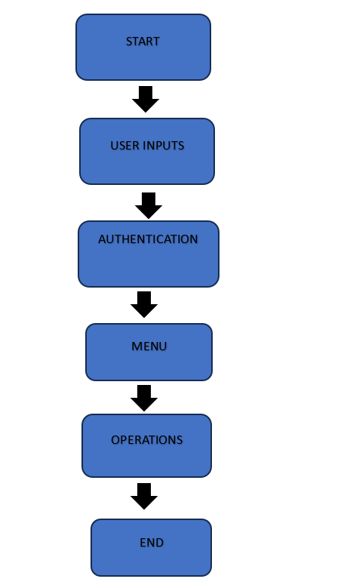
Architecture

Slide 7
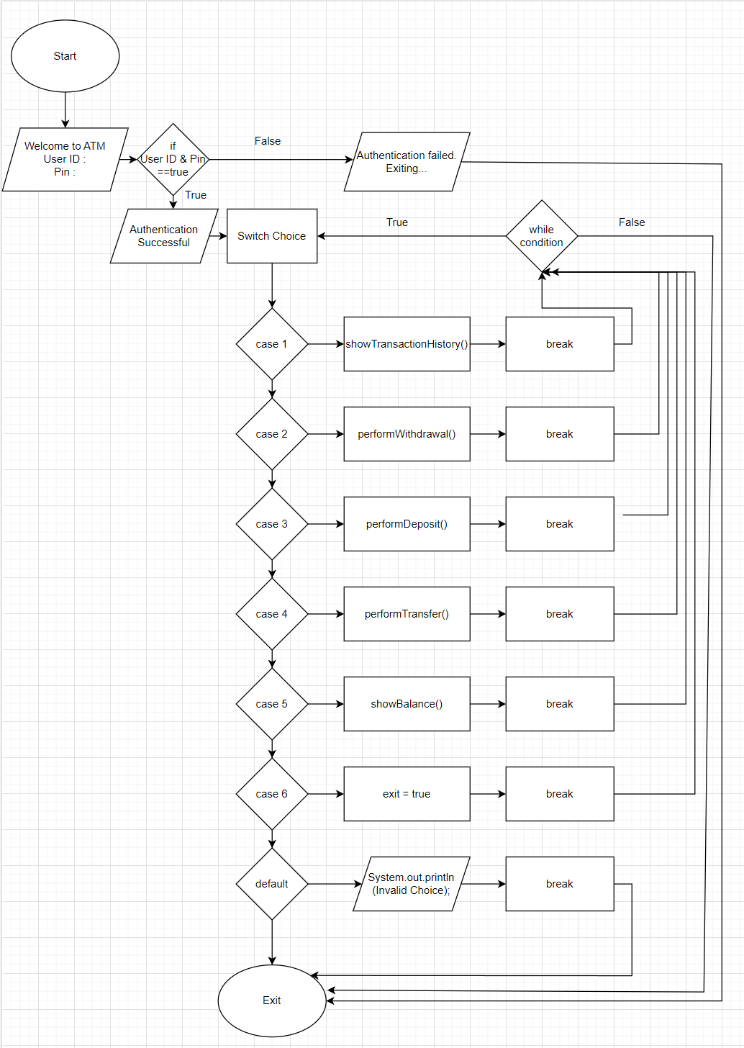
Flowchart

Slide 8
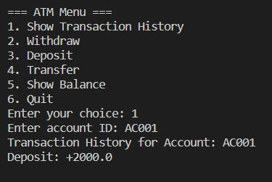
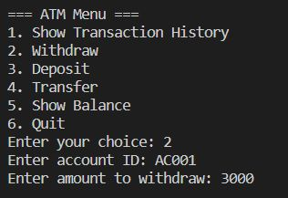
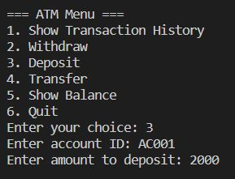
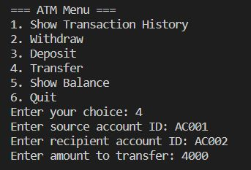
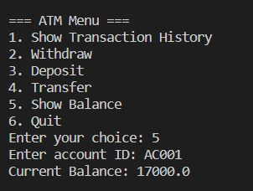
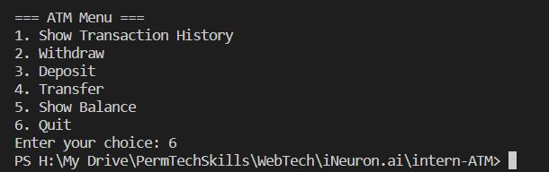
Output Screens

Slide 9
Conclusion
The ATM Interface in Java (Console-based Application) offers a practical and efficient solution for bank customers to manage their accounts and conduct essential banking operations through a text-based console interface. With its user-friendly design, secure authentication, and support for core banking functionalities, the application provides a seamless and reliable banking experience. By prioritizing simplicity, security, and responsiveness, the ATM Interface in Java proves to be a versatile solution, catering to users who prefer text-based interfaces or environments with minimal graphical capabilities. Overall, the ATM Interface in Java demonstrates the potential to deliver a convenient and secure banking experience, making it a valuable addition to the range of banking services available to customers.

Slide 10
THANK YOU
- SIDDUGANESH MUSA

